Slide 1


HR DATA ANALYSIS
MRINAL DESHMUKH

Slide 2
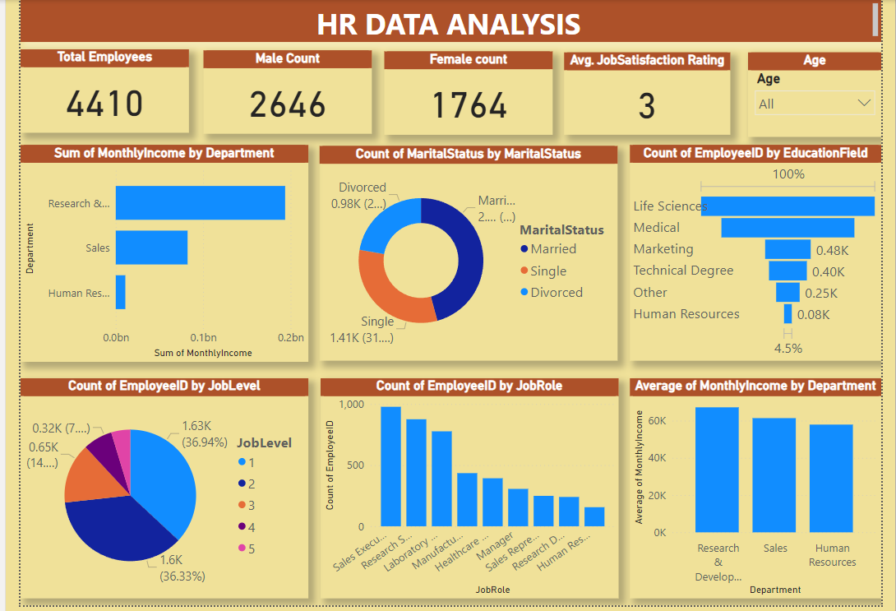

Slide 3
Data Insights
The average monthly income for employees is Rs. 65029
In data there are 60% male and 40% females.
We have highest number of employees in Sales Executive.
There are 3 departments named Research & Development, Sales and HR with almost 65% (0.2 Billion )of employees belonging to R&D employee.

Slide 4

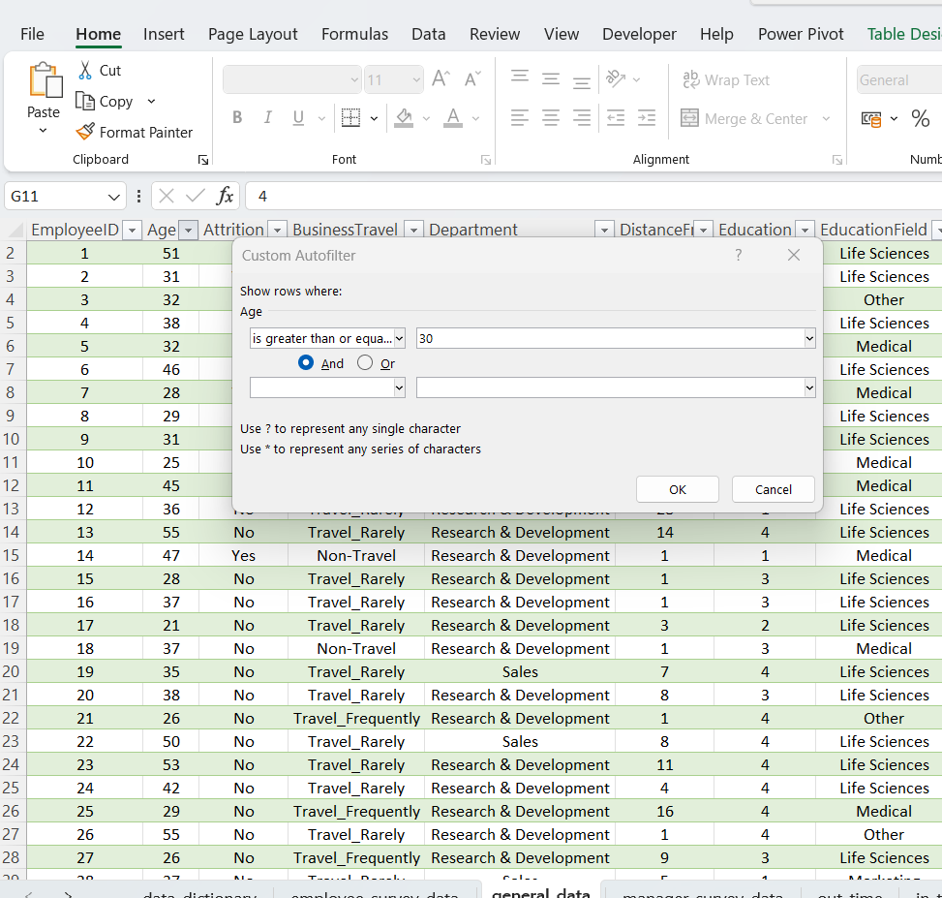
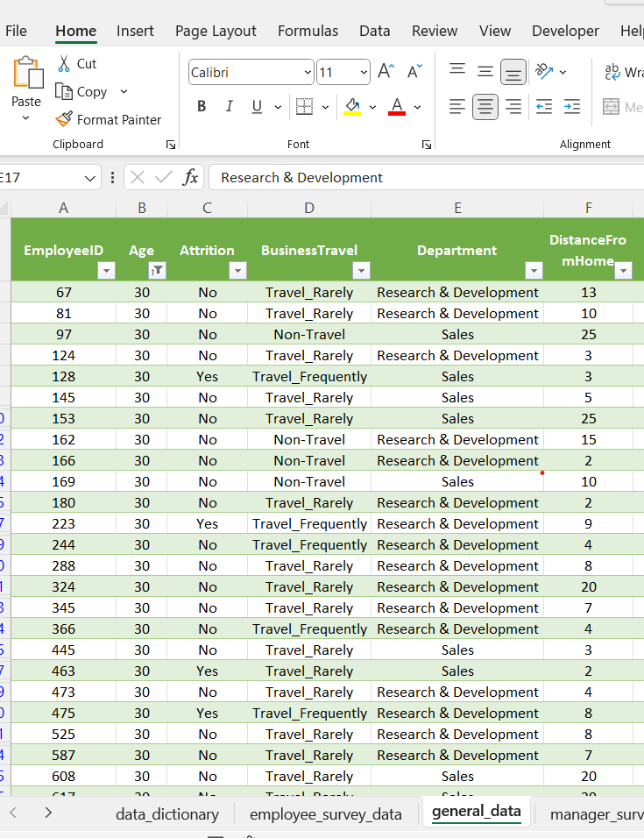
1. Using Excel, how would you filter the dataset to only show employees aged 30 and above?

Slide 5
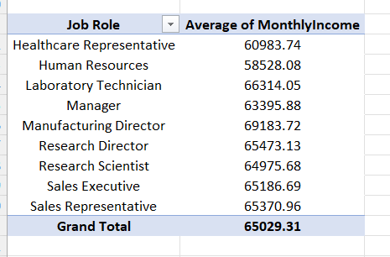
2. Create a pivot table to summarize the average Monthly Income by Job Role.

Slide 6
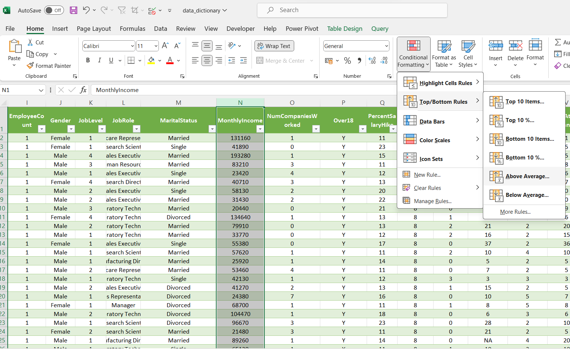
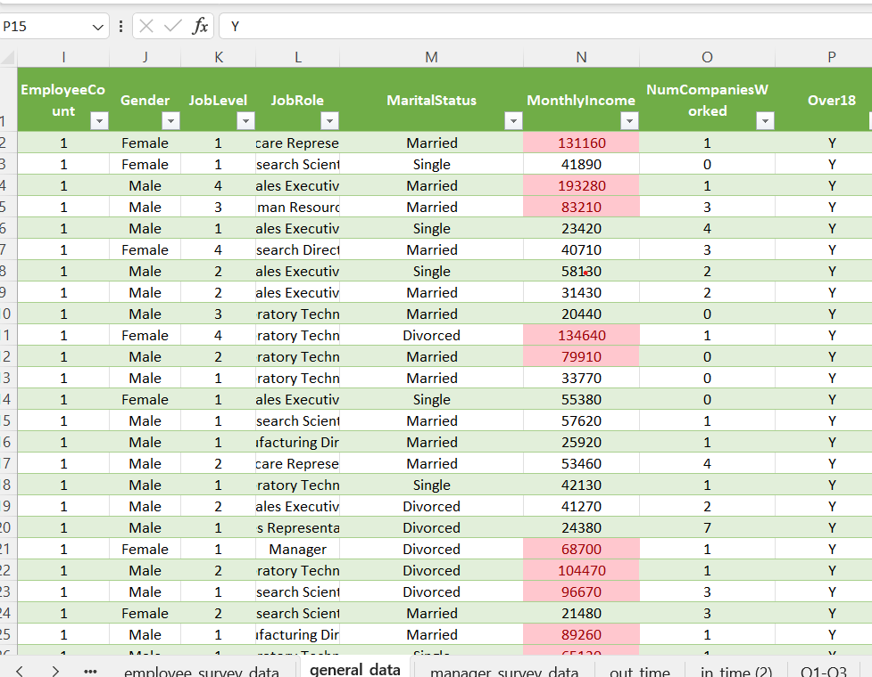
3. Apply conditional formatting to highlight employees with Monthly Income above the company's average income.

Slide 7
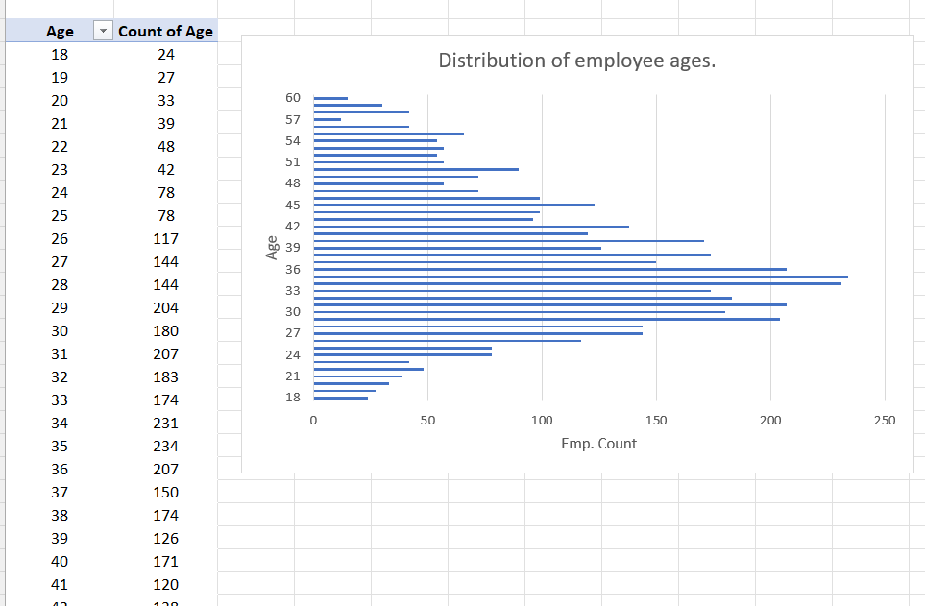
4. Create a bar chart in Excel to visualize the distribution of employee ages.
Make Effective Presentations
Using Awesome Backgrounds
Engage your Audience
Capture Audience Attention

Slide 8
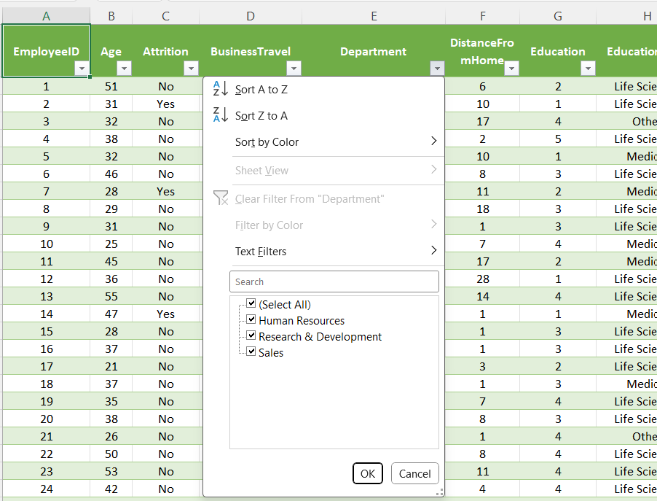
5. Identify and clean any missing or inconsistent data in the "Department" column.
There is no missing or inconsistent data found in the “department” column. or inconsistent data in the "Department" column.

Slide 9
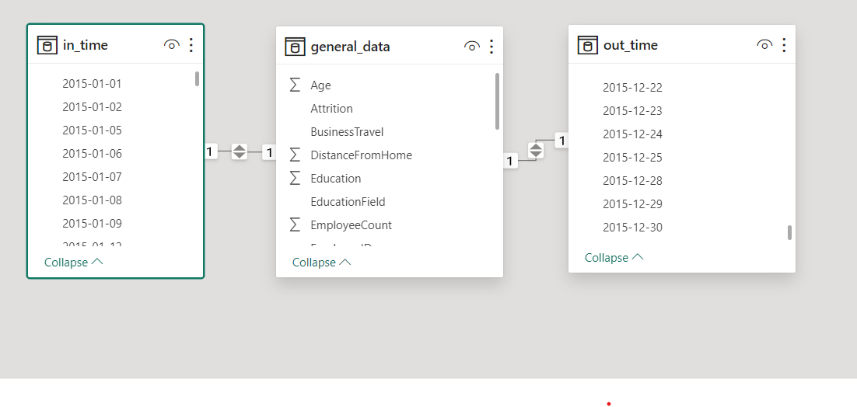
6. In Power BI, establish a relationship between the "EmployeeID" in the employee data and the "EmployeeID" in the time tracking data.

Slide 10
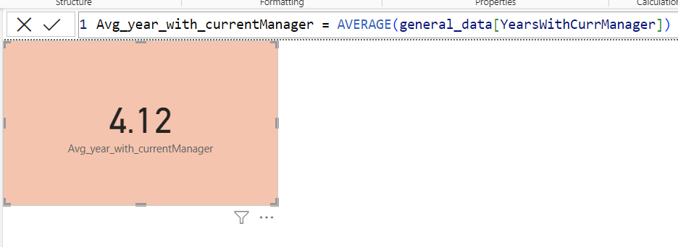
7. Using DAX, create a calculated column that calculates the average years an employee has spent with their current manager.

Slide 11
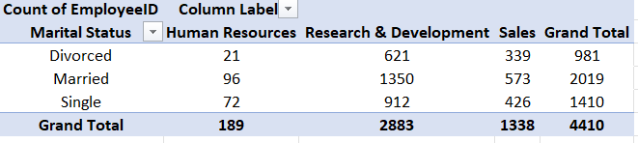
8. Using Excel, create a pivot table that displays the count of employees in each Marital Status category, segmented by Department.

Slide 12
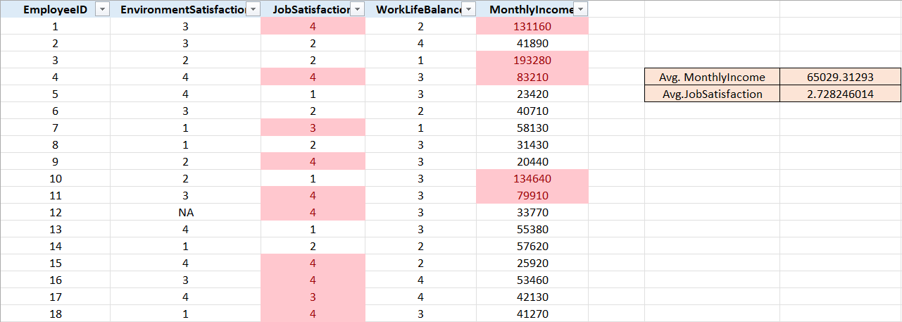
9. Apply conditional formatting to highlight employees with both above-average Monthly Income and above-average Job Satisfaction.

Slide 13
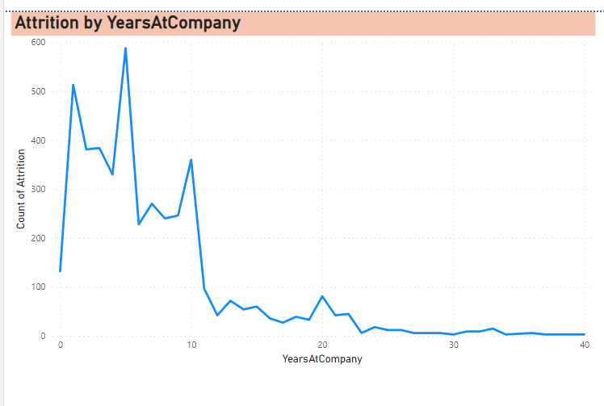
10. In Power BI, create a line chart that visualizes the trend of Employee Attrition over the years.

Slide 14
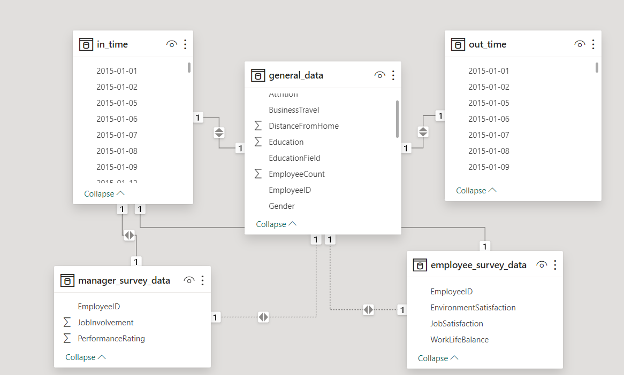
11. Describe how you would create a star schema for this dataset, explaining the benefits of doing so.
Star schema

Slide 15
To create a star schema for any data, you can follow these steps:
Identify Fact Table: Pinpoint the main focus (e.g., Department).
Identify Dimensions: List key attributes
Establish Relationships: Connect dimension tables to the fact table using keys.
De-normalize (Optional): Streamline dimension tables for performance.
Validate Schema: Ensure it meets analysis and scalability needs.
Implement Schema: Set up in your database, populating tables with data.
Benefits of star schema
Simplified structure for easy understanding.
Improved query performance due to fewer joins.
Scalability for large datasets.
Flexibility to add dimensions without disruption.
Enhanced aggregation capabilities.
Easier maintenance and query optimization.

Slide 16
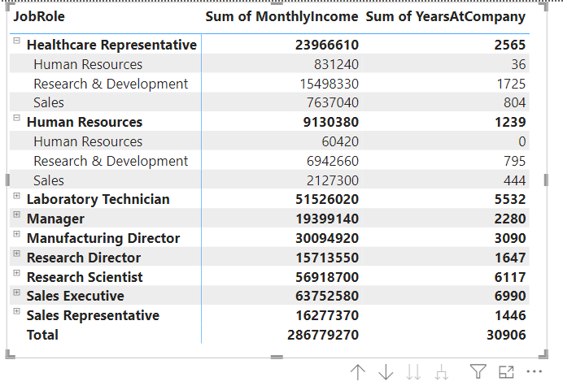
13. Create a hierarchy in Power BI that allows users to drill down from Department to Job Role to further narrow their analysis.

Slide 17
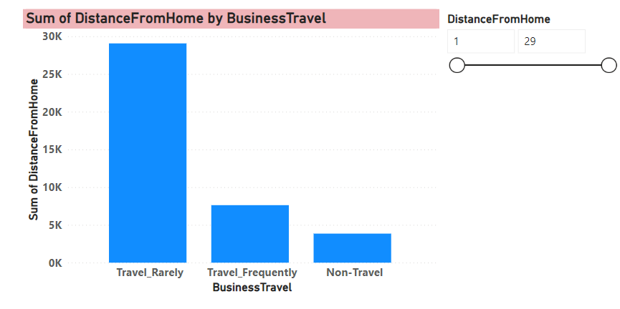
14. How can you set up parameterized queries in Power BI to allow users to filter data based on the Distance from Home column?

Slide 18
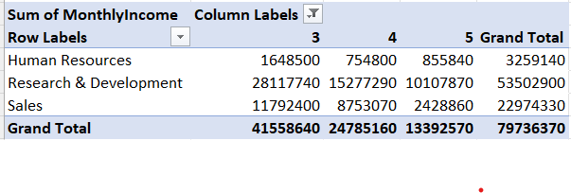
15. In Excel, calculate the total Monthly Income for each Department, considering only the employees with a Job Level greater than or equal to 3.

Slide 19
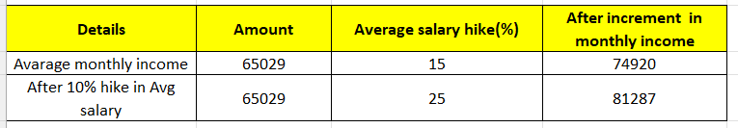
16. Explain how to perform a What-If analysis in Excel to understand the impact of a 10% increase in Percent Salary Hike on Monthly Income.

Slide 20
17. Verify if the data adheres to a predefined schema. What actions would you take if you find inconsistencies?
Actions for Inconsistencies required to take :
Data Cleansing:
Remove duplicates, correct invalid values, fill missing data.
Data Transformation:
Apply transformations using Power Query Editor.
Column Renaming or Formatting:
Rename or adjust formatting for consistency.
Adding Calculated Columns:
Create calculated columns or measures.
Rebuilding Relationships:
Adjust relationships in Power BI.
Documentation and Communication:
Document changes and communicate with stakeholders.

